Slide 1
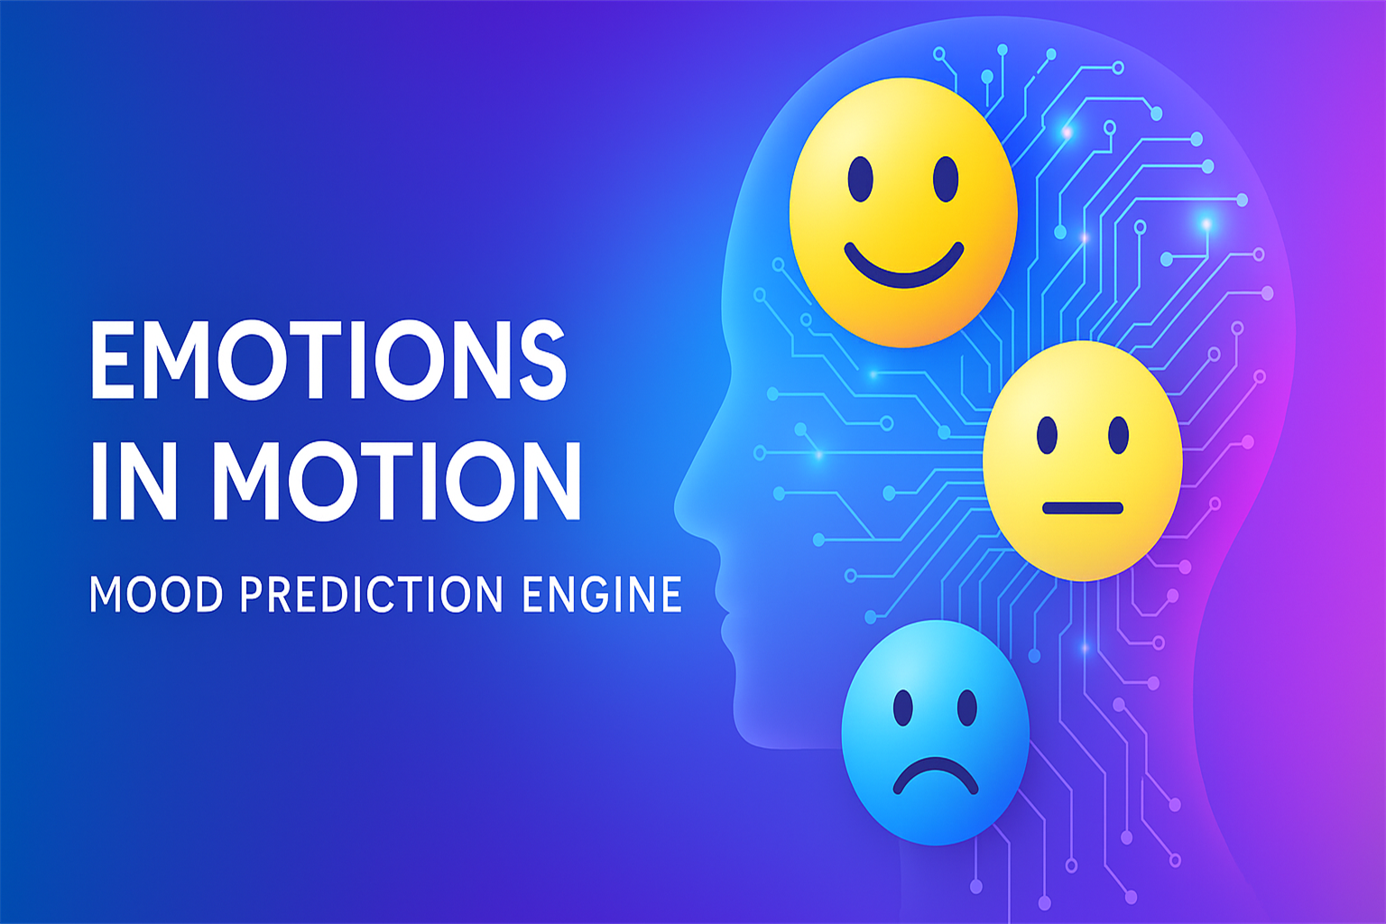

Prince Raj
August 2025

Slide 2
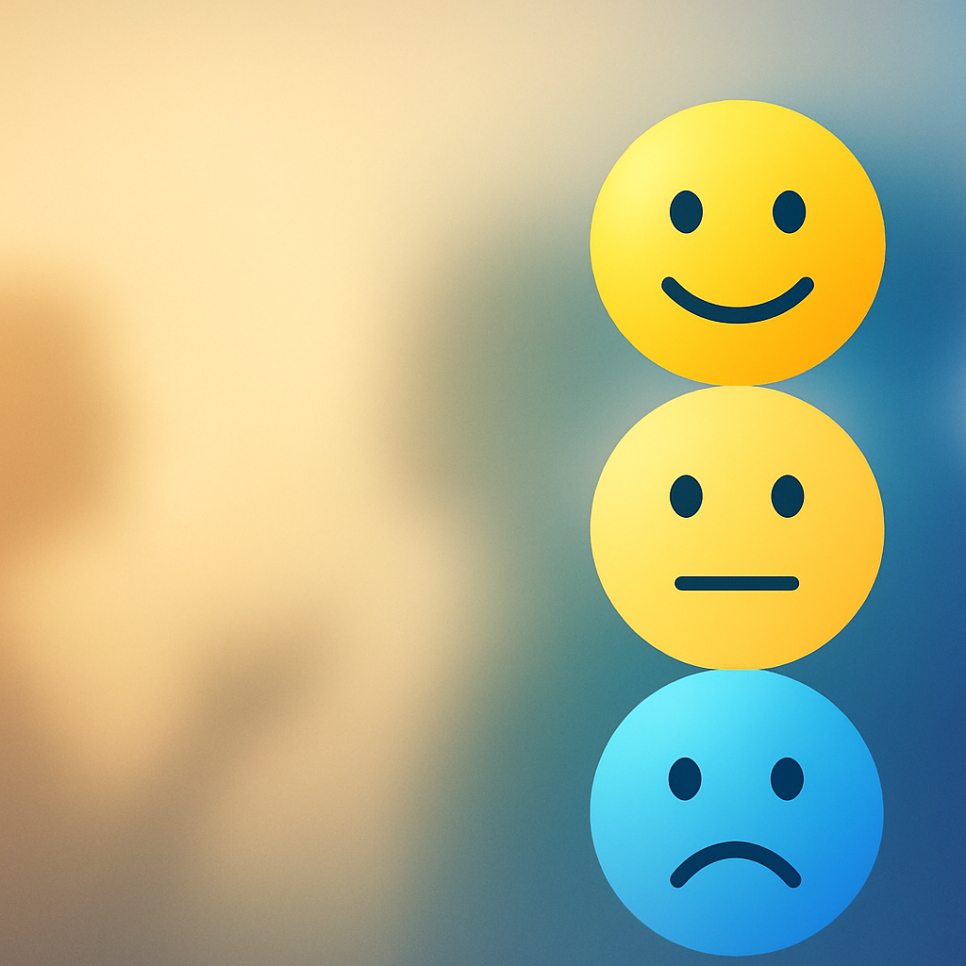
The Story Begins – Why This Project Matters
“We interact with technology daily. But what if tech could interact with our emotions?”
Every day, we go through different moods — joy, stress, fatigue, excitement. But what if our digital world could sense those changes?
I imagined a world where your smart device understands how you feel — and nudges you toward better habits.
That’s how this project was born: To explore if machines can learn to understand human mood through daily behavior.

Slide 3
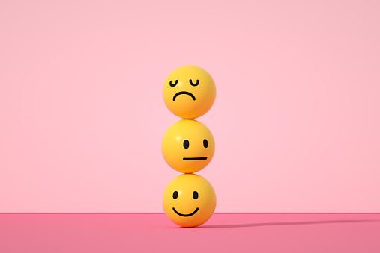
What This Project Aims to Do
I built a machine learning system that classifies human mood into Bad, Neutral, or Good using activity patterns and emotional signals like stress, energy, and intensity.
The vision: A future where mood-aware AI supports wellness, mental health, and productivity. Embed mood intelligence into smart devices, apps, wearables.

Slide 4
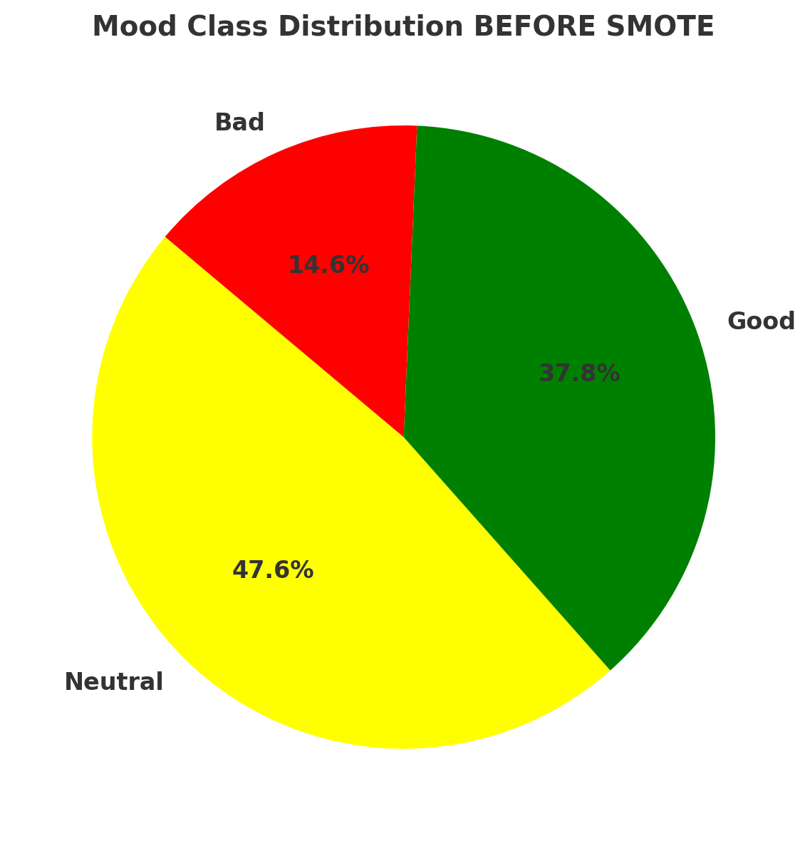
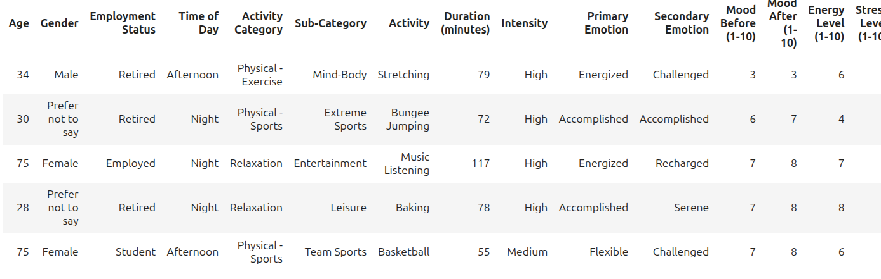
The Dataset – Fit-Life Simulation
I worked with a synthetic behavioral dataset of over 100,000 rows capturing how people live, move, and feel throughout their day.
Key features included:
Age, Gender, Employment
Type of Activity, Duration, Intensity
Mood Before/After, Energy, Stress
I converted Mood (1–10 scale) into 3 classes: Bad (1–3), Neutral (4–6), Good (7–10)

Slide 5
Project Pipeline
Let me show you the complete pipeline — from raw data to trained model.
Raw FitLife CSV
Missing Value Handling
Mood Class Conversion
Drop Leakage Columns
One-Hot Encoding
Train-Test Split
SMOTE Oversampling
StandardScaler
Model Training
Evaluation
Final Decision
Model Comparison

Slide 6
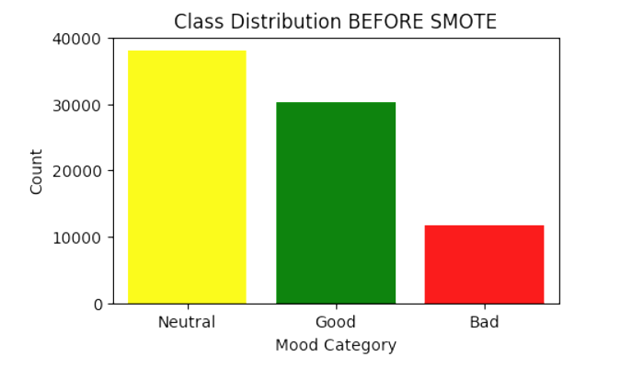
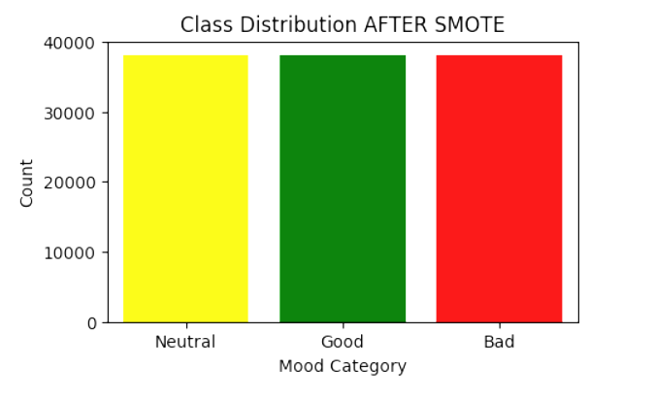
SMOTE Handling
The original dataset had very skewed mood distribution — Neutral was dominant. So, I used SMOTE (Synthetic Minority Over-sampling Technique) to balance the training data.
Before SMOTE
After SMOTE

Slide 7
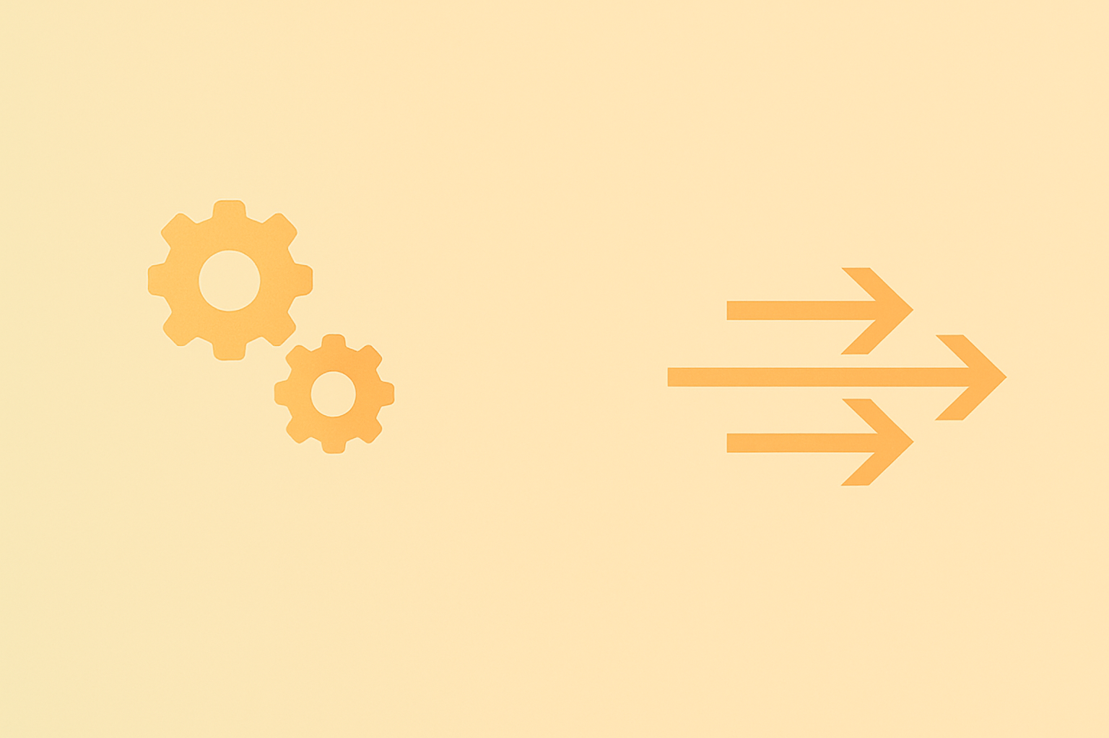
Feature Engineering
I dropped unnecessary columns like Date and Mood After to avoid leakage.
Then applied One-Hot Encoding → ended with 317 features.
For numeric fields like Age, Mood Before, Stress, I applied Standard Scaler - essential for deep learning models to converge properly.

Slide 8
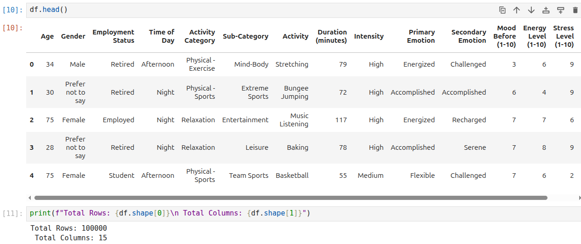

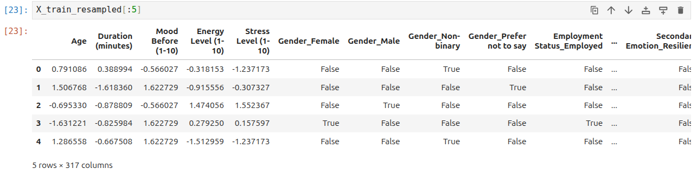

Feature Engineering
Before encoding
After One-hot encoding /
StandardScaler

Slide 9
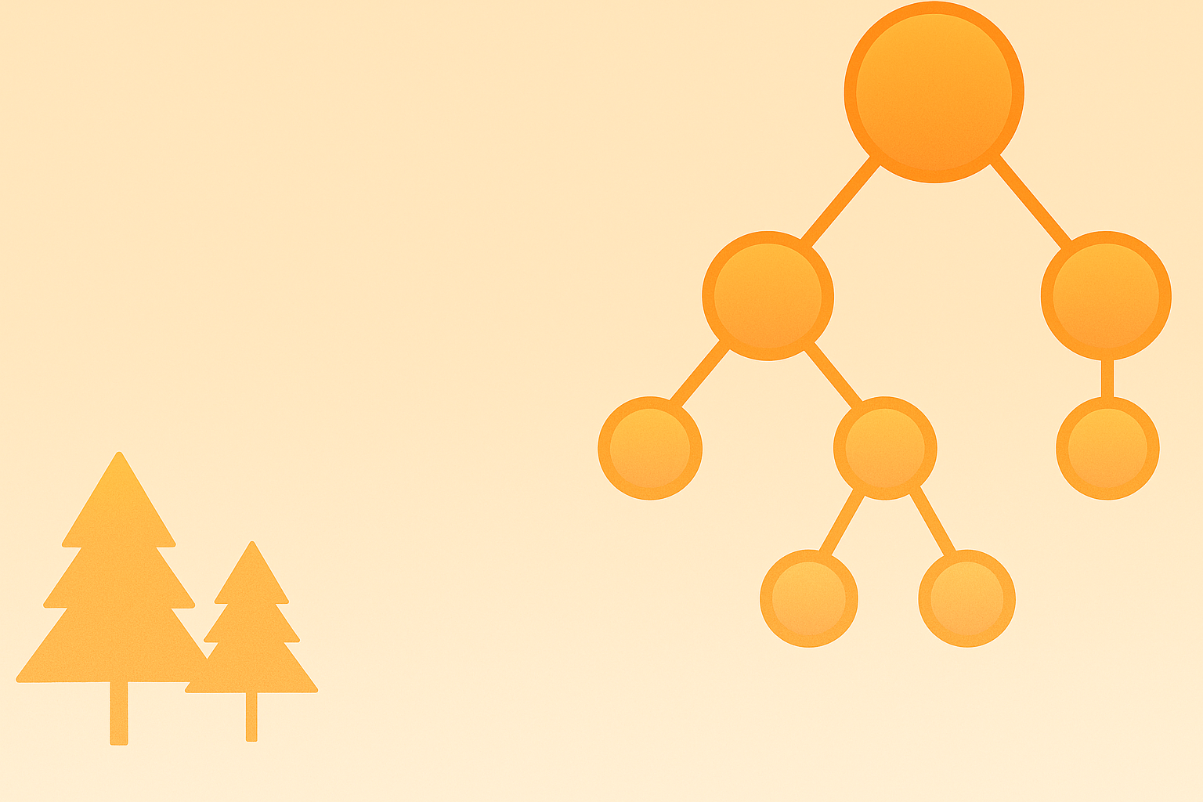
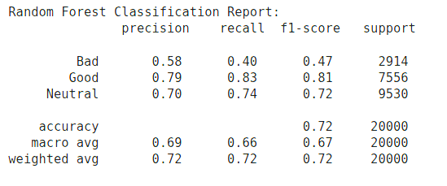
Model 1 – Random Forest
First, I trained a Random Forest to get quick, interpretable results.
Accuracy: 72.4%
Best at predicting Neutral / Good mood
Classification Report

Slide 10
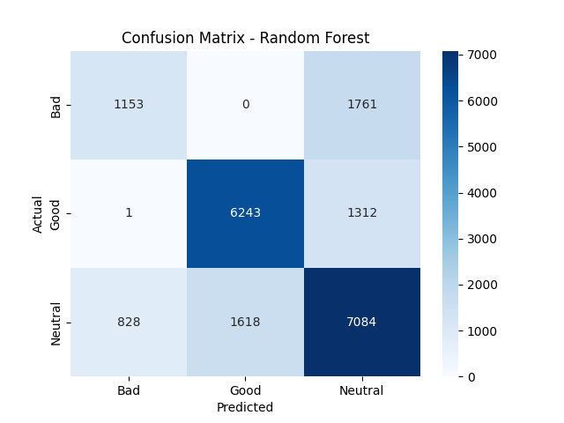
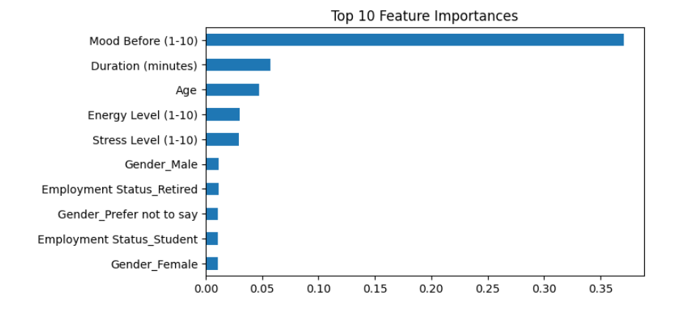
Model 1 – Random Forest
Confusion Matrix – RF
Top 10 Features – RF

Slide 11
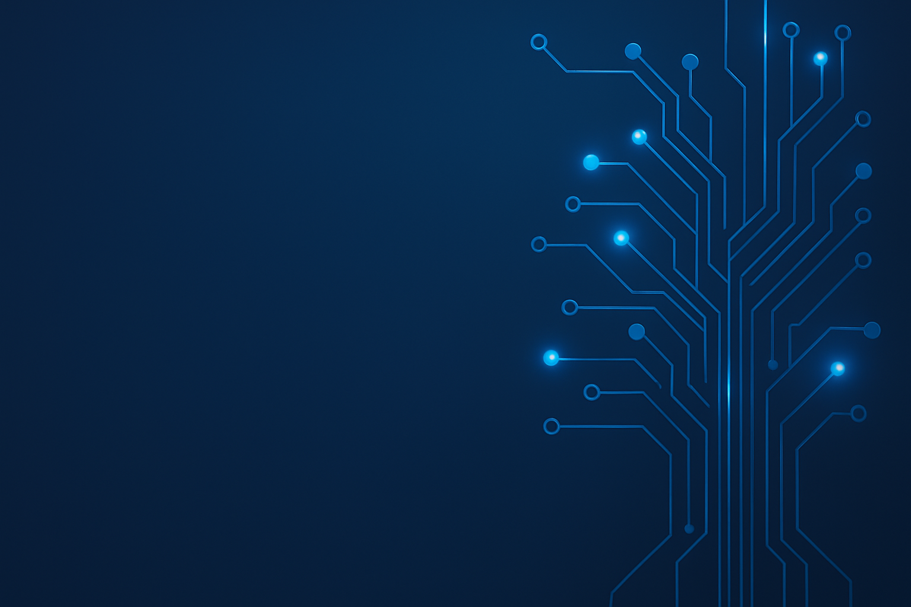
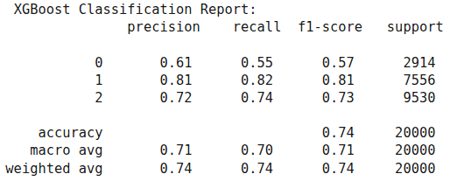

Model 2 – XGBoost
Then I trained XGBoost — A smarter learner with better interaction capture.
Accuracy: 74.1%
Best at predicting Bad mood
Classification Report

Slide 12
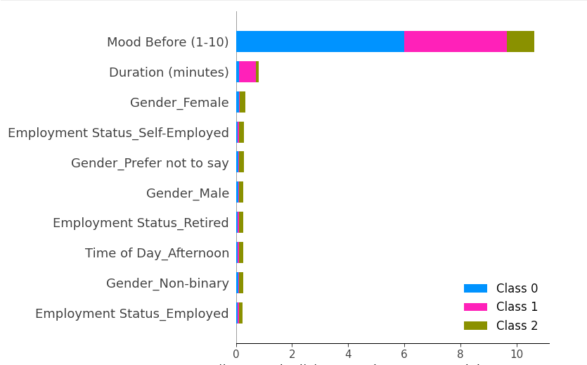
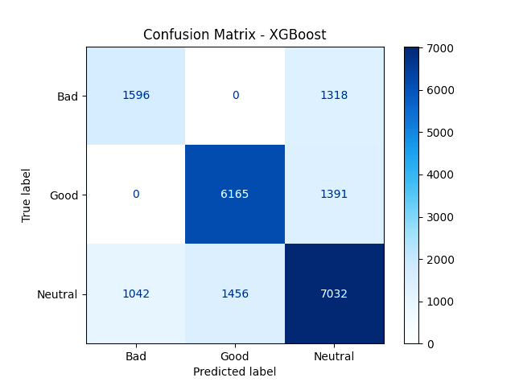
Model 2 – XGBoost
Feature Contributions (Top 10 – SHAP summary)
Confusion Matrix
SHAP reveals 'Mood Before', 'Duration', and 'Gender' as key signals.
XGBoost showed slightly better sensitivity to 'Bad' mood than Random Forest.

Slide 13
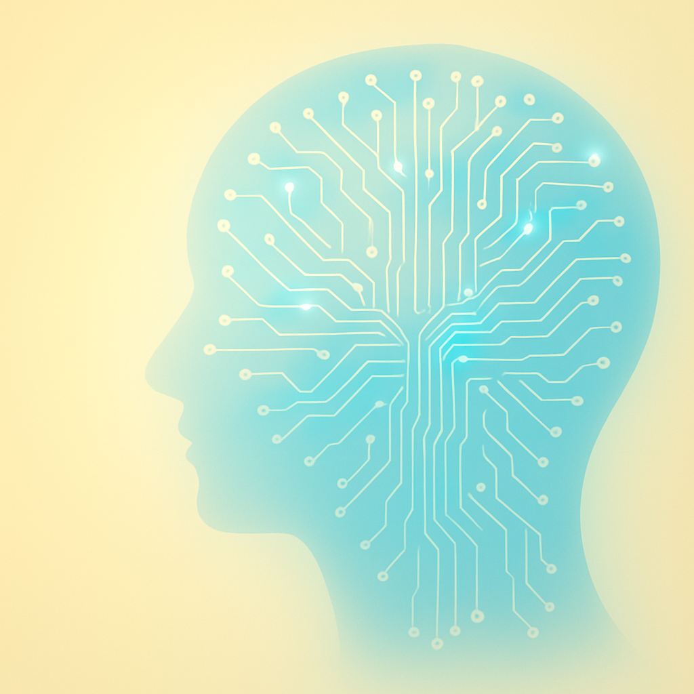
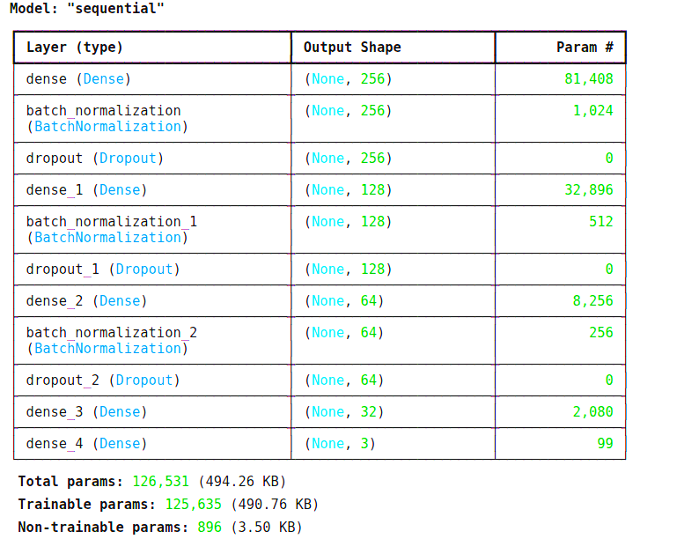
Model 3 – Deep Neural Network
Finally, I trained a DNN using batch normalization, dropout, and early stopping.
Accuracy: 74.2%
More consistent across all mood classes
DNN with 126K trainable parameters across 5 dense layers and regularization components.

Slide 14
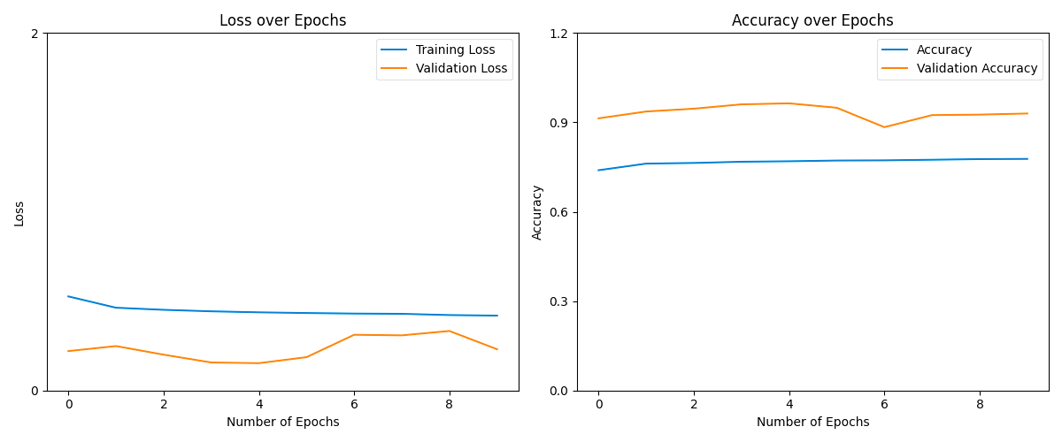
Model 3 – Deep Neural Network
Model showed stable training with minor variance in validation performance across epochs.

Slide 15
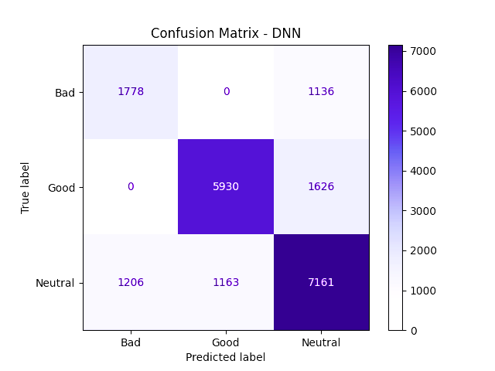
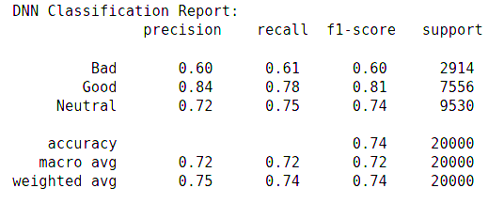
Model 3 – Deep Neural Network
Classification Report
Confusion Matrix

Slide 16

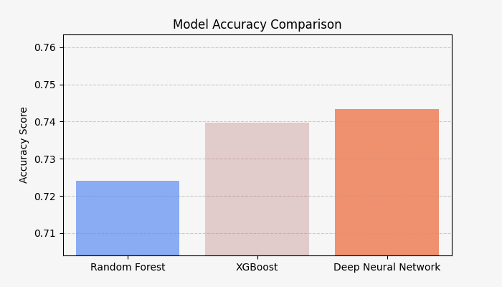
Model Comparison & Summary
All three models performed well — with DNN slightly ahead in overall accuracy.
Random Forest: ~72.4%
XGBoost: ~74%
DNN: ~74.2%

Slide 17

Final Takeaways
Mood is predictable — using activity + emotional signals
DNN gave best generalization
SHAP added transparency and trust
SMOTE made results more fair across mood classes

Slide 18
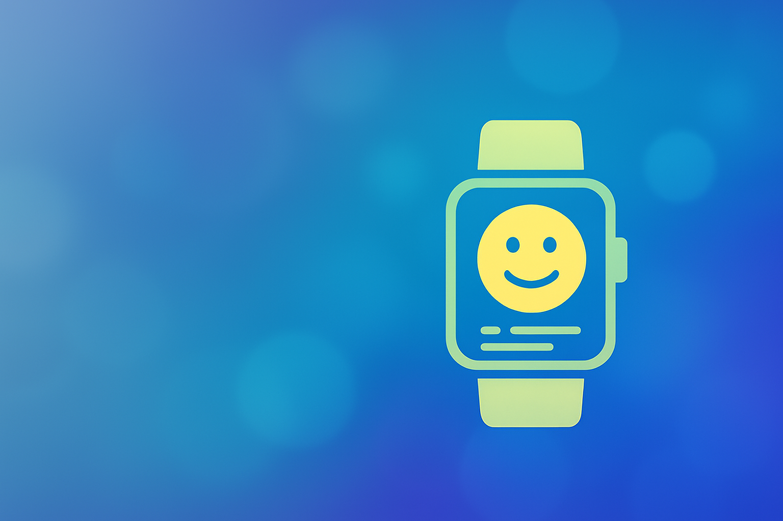
Future Vision
In future versions, this engine could:
Predict energy + stress along with mood
Be embedded into wearables or wellness apps
Adapt to real-time mood shifts using LSTM
Imagine your smartwatch saying:
“Hey , you’ve been low all morning. Want to stretch or take a walk?”

Slide 19

GitHub & Contact
Project Notebook, Graphs, and Code:
🔗 GitHub​
Connect with me:
🔗 LinkedIn​

Slide 20
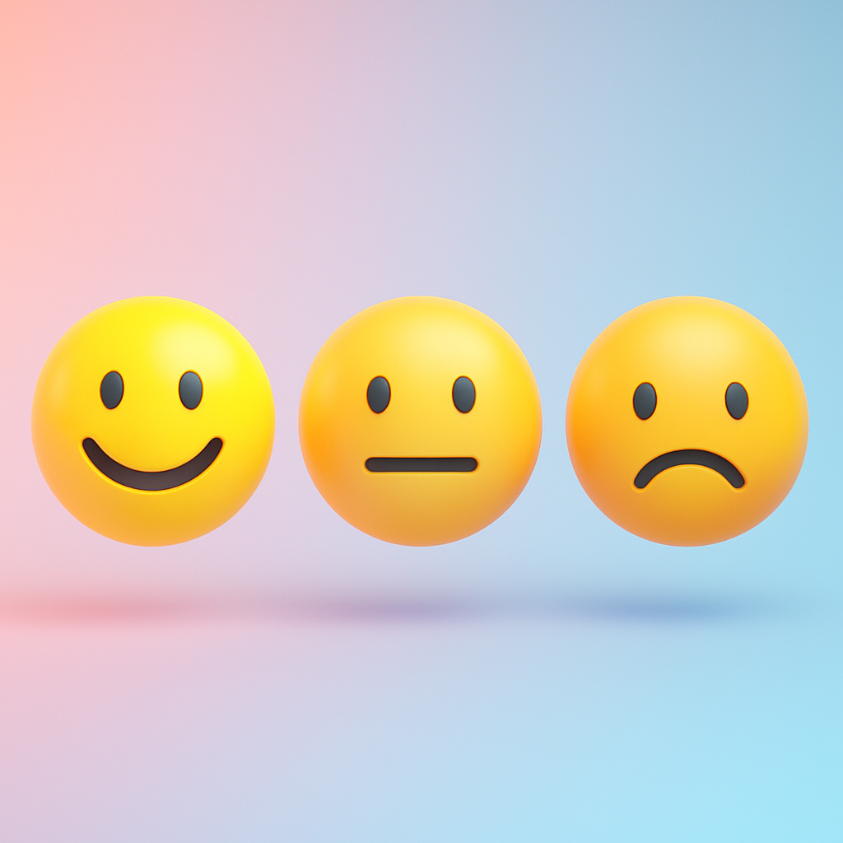
Thank You
Let's build AI that not only understands emotions — but truly cares.

